Slide 1



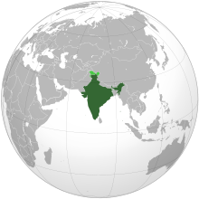


INDIAN CONSTITUTION

Slide 2
UNIT V FEDERAL SYSTEM
Federalism is part of the basic structure of the Indian constitution which cannot be altered or destroyed through constitutional amendments under the constituent powers of the Parliament without undergoing judicial review by the Supreme Court.

Slide 3
Financial powers
Article 282 accords financial autonomy in spending financial resources available to the states for public purposes.
Article 293 allows States to borrow without limit without consent from the Union government
The President of India constitutes a Finance Commission every five years to recommend devolution of Union revenues to State governments.
Under Article 360, the President can proclaim a financial emergency when the financial stability or credit of the nation or of any part of its territory is threatened. However, no guidelines define "financial emergency" for the country or a state or union territory or a panchayat or a municipality or a corporation

Slide 4
Financial powers
The President can reduce the salaries of all government officials, including judges of the supreme court and high courts, in cases of a financial emergency.
All money bills passed by the state legislatures are submitted to the President for approval. He can direct the state to observe economy measures.

Slide 5
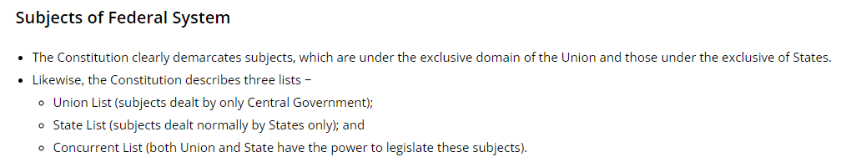

Slide 6
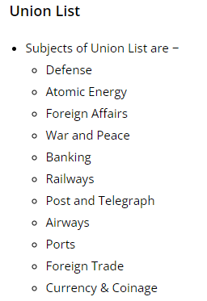
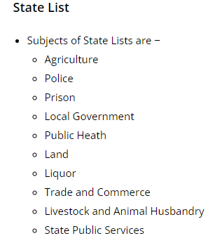

Slide 7
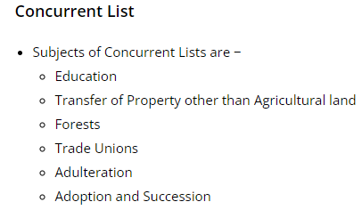

Slide 8
Union list
The Union Government has the authority to make laws relating to the subject matter given under the list I, called the Union list. It includes taxes like Corporation Tax, Customs and Excise duties and taxes on income other than agricultural income, etc.

Slide 9
State List
The State Government is vested with the power to frame laws on the subjects mentioned under list II, called the state list. It includes taxes on vehicles, liquors, land revenue, entertainment, luxuries, stamp duties and sale or purchase of goods, etc.

Slide 10
Concurrent List
While there is another list also known as the Concurrent List, which gives power to both the centre as well as state government to make laws with regards to the subjects provided by the list III. List III does not include any major tax as such. This helps in avoiding the competitive exploitation of the same source by both the authorities and the overlapping of tax-jurisdictions under the Indian Constitution. Further, in the case of conflict, the central government decision will prevail over the State government decision.

Slide 11
Distribution of powers – Levying and collection of taxes
Article 268 to 281 of the Indian Constitution has made elaborate provisions that provide directions to the centre relating to the distribution of financial resources amongst the states.

Slide 12
The provisions, for the time being, can be summarised as follows but will be explained in detail further. It includes:
Taxes levied by the Union but collected and kept by the States (Article 268).
Taxes levied and collected by the Union but assigned to the States (Article 269).
Taxes levied and distributed between the Union and the States (Article 270).
Grant-in-aid from the Centre to the States (Article 273, Article 275 and Article 282).
Sharing of proceeds from other taxes.
In giving recommendations with regards to the distribution of funds between the centre and state, the Finance commission mentioned under Article 280 plays a very important role.

Slide 13
GST Regime – 101st Amendment
The 101st Amendment in the constitution and the introduction of GST in the Indian Economy has significantly changed the landscape of financial relations between the centre and states. Therefore, it is extremely important to have a basic knowledge of what GST is, its application and its different forms.

Slide 14
Position before GST
Before the introduction of GST, there were multiple taxes imposed by the centre and states separately and the distribution of which was confusing and non-uniform. It included Service Tax, Central Excise, Customs duty and State VAT etc. But after the GST, the principle of one nation one tax was adopted.
Position before GST
GST is categorized into CGST, SGST or IGST depending on whether the transaction is Intrastate or Interstate supplies. Let’s understand what does this means:

Slide 15
Inter-state and Intra-state Supplies
Intra-State supply of goods or services: In these kinds of transactions, the location of the supplier and the place of supply are in the same state.
ii) Inter-State Supply of Goods and Services: As per the Section 7 of The Integrated Goods, and Services Tax Act 2017 it can be understood that “Inter-state” trade or commerce basically means:
when the supplier is located in some other state or union territory and the place of the supply is in another state/UT, or
when the supply of goods or services is made to or by a Special economic zone (SEZ) unit.

Slide 16
Central Goods and Services Tax (CGST)
CGST is a tax imposed on Intra-state supplies of goods and services and is governed by the CGST Act. Along with this SGST/UTGST will also be levied on the same transaction and shall be governed by the SGST/UTGST Act.
It implies that in the case of Intra-state supplies of goods and services both CGST and SGST are combined which are collected simultaneously; where CGST goes to the centre and SGST goes to the state.
The proportion of SGST and CGST is equal.
However, it must be noted that any tax levied on Intra-State supplies of goods and/or services by the centre and state shall not exceed 14% each.

Slide 17
State Goods and Services Tax (SGST)
The SGST is a tax levied by the state on the Intra State supplies of goods and/or services by the State Government.
It is governed by the SGST Act.
As already mentioned above it is levied and collected simultaneously with the CGST.
In the case of Union territories, it is called UGST and governed by the UGST Act.

Slide 18
Integrated Goods and Services Tax (IGST)
IGST or Integrated Goods and Services Tax is a tax levied on all Inter-State supplies of goods and/or services.
It is governed by the IGST Act.
IGST applies on any supply of goods and/or services in case of both import into India and export from India. Though the exports will be zero-rated.
Tax obtained under IGST is shared between centre and states as per Article 269A.
The biggest achievement of GST is that it introduced a single uniform tax system with dual tax features where the revenue is shared between both centre and state.

Slide 19
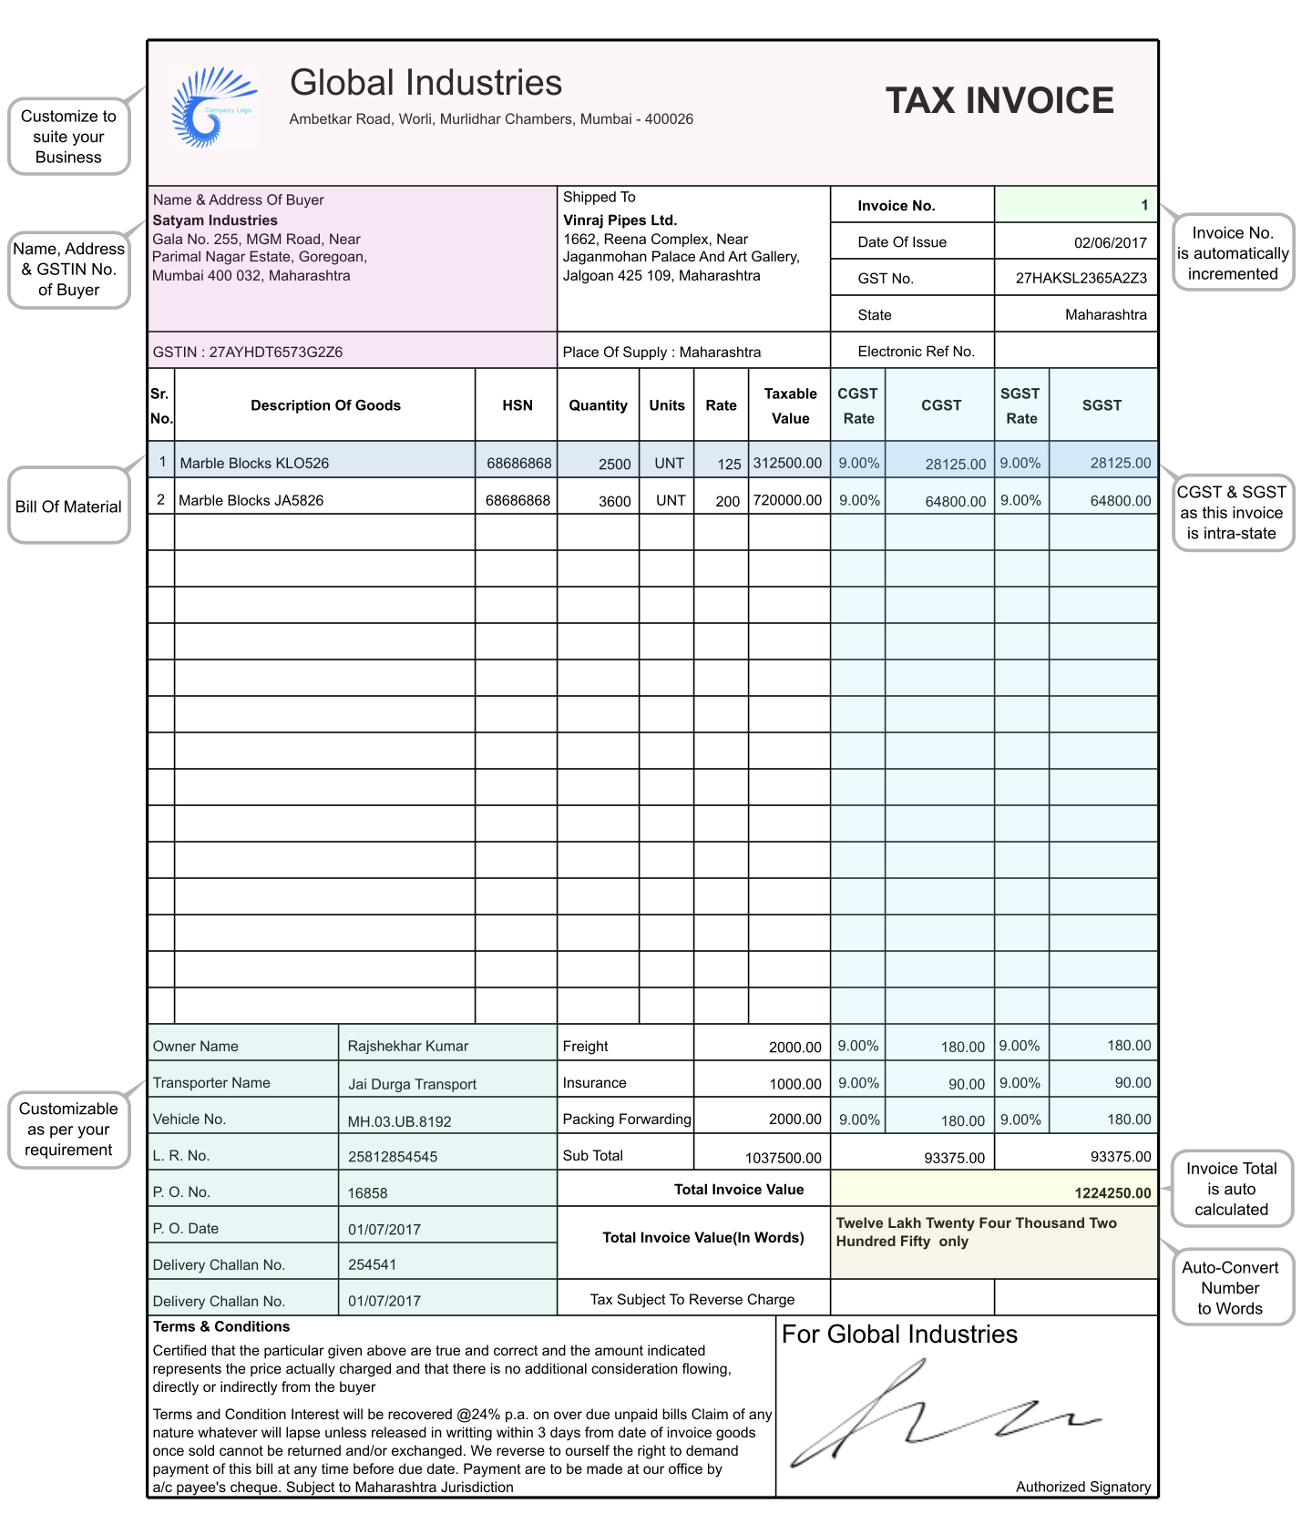

Slide 20
Composition of GST Council
The members of the council will be as follows:
The Union Finance Minister of India will serve as the chairperson of this council.
The respective states will nominate the State Finance Ministers/ or any other Minister as the member of the council.
The Union Minister of State in charge of revenue or finance will also be a member of this council.
The representatives of the states shall choose amongst themselves one “Vice-president”.

Slide 21
Effect of Emergency on Centre-states Financial Relation
During National Emergency
The President in situations of Emergency can order that all grant-in- aids received by the states by the Union shall remain suspended. However, such suspension is only temporary in nature and cannot go beyond the expiration of the financial year in which the Proclamation of Emergency ceases to operate.

Slide 22
During Financial Emergency
The Centre-States financial relations changes considerably in case if Financial Emergency is imposed as per Article 280 of the Indian Constitution.
In such cases, the Centre becomes so powerful and exercises immense control over the States compelling them to observe certain norms of financial propriety and other essential safeguards.
The Union government can give the following mentioned directions to the States-

Slide 23
During Financial Emergency
It includes directions to State Governments regarding the reduction of the salary and allowances of all the employees engaged in service of the State which even includes judges of the High Courts.
In situations of Financial Emergency, the President has the power to make an alteration in the distribution and allocation of taxes from the Centre to the States and to direct the States to observe principles of Financial propriety as laid down by the Parliament.
Further directions can also be issued compelling the states to reserve the consideration of the President on all financial and money bills even after they have been passed by the State Legislature.

Slide 24
-THANK YOU-

